Slide 1
Function Design Recipe (FDR)
Dr Mohammed Bahja
2023-2024

Slide 2
This week
Function Design Recipe (FDR):
A systematic approach to crafting functions.
Docstring:
Definition: A built-in string that describes a function or a module.
Purpose: Provides clarity on the function's purpose, parameters, and expected output.
Doctest:
Definition: A tool embedded within Python to easily test functions.
Benefit: Embed test cases within the docstring to automatically validate function outputs.
Algorithm Design:
Understand the process of creating a sequence of steps to solve a specific problem.
Top-Down Design:
An approach to software design where you break down a system to gain insight into its compositional sub-systems.

Slide 3
This week
6. Define a recursive function
7. Define a function with required and optional parameters
8. Use higher-order functions for mapping, filtering, and reducing

Slide 4
Understanding Functions in Programming
Mathematical Functions:
Examples: sqrt (square root), sin (sine), log (logarithm)
Purpose:
Reusability: Eliminates the need to repeatedly write complex equations.
Readability: Makes complex calculations more intuitive and legible.
Programming Functions:
Examples: print (displays content), input (receives user data), round (rounds numbers)
Purpose:
Reusability: Avoids repetition of common code instructions.
Readability: Streamlines code by abstracting common tasks, making the overall program more understandable.
Divide-and-Conquer Approach (Division of Labor ):
Definition: A strategy that divides a larger problem into smaller, manageable sub-problems.
Benefits:
Simplifies complex problems.
Each sub-problem can be addressed as an individual function, enhancing modularity and maintainability.

Slide 5
Built-in functions
General Syntax:
Format: function_name(arguments)
Use built-in functions without the need for extra coding or importing.
Functions can be nested or combined in expressions for more complex operations
>>> int(34.6)
34
>>> int(-4.3)
-4
>>> abs(-7) + abs(3.3)
10.3
>>> pow(abs(-2), round(4.3))
16
>>> abs(-9)
9
>>> abs(3.3)
3.3
>>> float(21)
21.0

Slide 6
User-Defined Functions in Python
Why User-Defined Functions?
Built-in functions are versatile, but they are general in nature.
For specific tasks not covered by built-in functions, we can craft our own functions.
Examples: Convert Fahrenheit to Celsius, calculate mileage.
Defining a Function:
A user-defined function begins with the def keyword.
Syntax:
Returning Values:
Functions can produce and return values using the return statement.
This allows functions to provide results that can be used in other parts of the code.
def function_name(parameters):
block_of_code
def function_name(parameters):
block_of_code
return expression

Slide 7
User-Defined Functions in Python
Why User-Defined Functions?
Built-in functions are versatile, but they are general in nature.
For specific tasks not covered by built-in functions, we can craft our own functions.
Examples: Convert Fahrenheit to Celsius, calculate mileage.
def fahrenheit_to_celsius(fahrenheit):
"""
Convert a temperature from Fahrenheit to Celsius.
Parameters:
- fahrenheit (float): Temperature in Fahrenheit.
Returns:
- float: Corresponding temperature in Celsius.
"""
celsius = (fahrenheit - 32) * 5/9
return celsius

Slide 8
User-Defined Functions in Python
Why User-Defined Functions?
Built-in functions are versatile, but they are general in nature.
For specific tasks not covered by built-in functions, we can craft our own functions.
Examples: Convert Fahrenheit to Celsius, calculate mileage.
# Convert 98.6°F (average human body temperature) to Celsius
celsius_temp = fahrenheit_to_celsius(98.6)
print(f"98.6°F is equivalent to {celsius_temp:.2f}°C.")
# This will print: 98.6°F is equivalent to 37.00°C.

Slide 9
Function Parameter vs Function Argument
Function Parameter:
Definition: A variable listed inside the parentheses in the function definition.
Purpose: It acts as a placeholder for the values, which will be passed to the function when it is called.
Example:
Function Argument:
Definition: The actual value that is passed into the function when it is called.
Purpose: It provides the real data for the function to operate on.
Example:
def greet(name): # 'name' is a parameter
print(f"Hello, {name}!")
greet("Alice") # "Alice" is an argument

Slide 10

Crafting User-Defined Functions: A Thoughtful Process
Writing a Good Essay: A Systematic Approach
Choose a Topic: The foundation of your essay. Dictates direction and theme.
Research & Gather Background Material: Ensure a well-informed and comprehensive perspective.
Draft an Outline: Establish a structure; determine key points and their flow.
Expand & Detail the Outline: Dive deep, provide evidence, analysis, and elaborate on each point.
What about writing a good function?

Slide 11
Crafting User-Defined Functions: A Thoughtful Process
Developing a Well-Defined Function: A Methodical Journey
Name the Function: A descriptive name is crucial. It should encapsulate the function's core purpose. E.g., calculate_area().
Determine the Parameters: Decide the necessary inputs. For a rectangle area function: length & width.
Define Parameter Types: Ensures correct data handling. E.g., Strings, Integers, Lists.
Specify Return Values: What will the function output? Is it a number, a string, a list?
Note: Proper planning in both essay writing and function development ensures clarity, efficiency, and effectiveness.

Slide 12

Badly Written Function
def area(x, y):
return x * y

Slide 13
Badly Written Function
Issues:
Ambiguous Function Name: The name area is too general. It doesn't specify what shape's area it calculates.
Unclear Parameters: x and y don't clearly signify what they represent.
Lack of Documentation: There's no docstring to guide a user or developer on how to use the function or what it's for.
No Input Validation: The function doesn't handle potential issues, like negative values.
def area(x, y):
return x * y

Slide 14

Well-Written Function
def rectangle_area(length, width):
"""
Calculate the area of a rectangle.
Parameters:
- length (float): Length of the rectangle.
- width (float): Width of the rectangle.
Returns:
- float: Area of the rectangle.
"""
if length < 0 or width < 0:
return "Length and width must be non-negative values.”
return length * width

Slide 15
Well-Written Function
Improvements:
Descriptive Function Name: The name rectangle_area clearly specifies its purpose.
Clear Parameters with Type Annotations: length and width are understandable, and type hints provide additional clarity.
Detailed Documentation: The docstring explains the purpose, parameters, and return value.
Input Validation: The function checks for negative values and raises an error if found.

Slide 16

Function design recipe (FDR)
The Function Design Recipe provides a design method for constructing functions.
It is a framework for approaching any programming problem, in any coding language.
FDR facilitates problem-solving by breaking down complex tasks into manageable steps.

Slide 17
Function Design Recipe (FDR): A Step-by-Step Guide
Define the Problem:
Begin by understanding the core problem you aim to solve. Ask questions like:
What is the task at hand?
What is the desired outcome?
Example Scenarios:
Create a list of examples illustrating the expected behavior of the function. This helps in understanding the problem better and serves as a reference for testing later.
For instance, if designing a function to add two numbers, an example would be: 3+2=5

Slide 18
Function Design Recipe (FDR): A Step-by-Step Guide
3. Naming the Function:
Choose a descriptive and concise name for the function that reflects its purpose.
Avoid generic names like "doSomething" or "compute."
Instead, opt for names like "addNumbers" or "calculateArea."
4. Identifying Inputs:
Determine what data or arguments the function requires to work.
Specify the data type for each input (e.g., integer, string, list).
For instance, a function that calculates the area of a rectangle would need two inputs: length and width, both of which could be of float or integer type.

Slide 19
Function Design Recipe (FDR): A Step-by-Step Guide
5. Determining Outputs:
Identify what the function should return after processing the inputs.
Clearly define the type of the output (e.g., integer, string).
Using the rectangle example: the function would return the area, which would be of type float or integer.
6.Developing the Solution:
This is where you'll write the actual code or logic of the function.
Break down the problem into smaller tasks or steps.
Implement each step methodically, keeping in mind the examples you've listed.

Slide 20
Function Design Recipe (FDR): A Step-by-Step Guide
7. Testing the Solution:
Once your function is implemented, use the examples you listed earlier to test its correctness.
Check if the function returns the expected outputs for the given inputs.
It's also a good practice to test with some edge cases or unexpected inputs to ensure robustness.

Slide 21

Function Design Recipe (FDR): A Step-by-Step Guide
Header
Type contract
Description
Examples
Body
Test

Slide 22
Function Design Recipe (FDR) for days_difference Function
Header
Type contract
def days_difference(day1, day2):
(int,int)→int
This indicates that the function takes in two integers and returns an integer.

Slide 23
Function Design Recipe (FDR) for days_difference Function
3. Description:
Return the number of days between day1 and day2, which are both in the range 1-365 (thus indicating the day of the year).
4. Examples:
These are examples that demonstrate expected behavior:
5. Body:
This is the core logic of the function:
>>> days_difference(200, 224)
24
>>> days_difference(50, 50)
0
>>> days_difference(100, 99)
-1
return day2 - day1

Slide 24
Function Design Recipe (FDR) for days_difference Function
6- Test:
Once the function is implemented, it should be tested with various inputs to ensure its correctness.
Embed your test cases within the function's docstring, and then run doctest to execute those tests.
def days_difference(day1, day2):
"""
(int, int) -> int
Return the number of days between day1 and day2, which are
both in the range 1-365 (thus indicating the day of the year).
>>> days_difference(200, 224)
24
>>> days_difference(50, 50)
0
>>> days_difference(100, 99)
-1
"""
return day2 - day1
if __name__ == "__main__":
import doctest
doctest.testmod(verbose=True)

Slide 25
doctest: Streamlining Python Testing
What is doctest?
An in-built Python module that turns your docstrings into test cases.
It identifies text resembling interactive Python sessions within docstrings and executes them.
Key Features:
Automatic Verification: Ensures code snippets in docstrings work precisely as illustrated.
Simplicity: No need for a separate test file; write tests directly within your functions or methods.
Interactive Session Replication: Makes your documentation more informative and verifiable.
Common Usage:
Embed test cases within a function's docstring.
Run doctest.testmod() to execute the tests.
View results: No news is good news! (i.e., no output means all tests passed.)
Or use doctest.testmod(verbose=True) to see a report anyway
Learn More:
https://docs.python.org/3/library/doctest.html

Slide 26
Practice
Following the function design recipe, define a function that takes in a string of text and counts the occurrences of each word. The function should return a dictionary where the keys are the words and the values are the counts. Words should be considered case-insensitive, and punctuation should be ignored. Further, write the doctest instructions to test it.

Slide 27
Practice
def word_count(text):
"""
str -> Dict[str, int]
Count the frequency of each word in the provided text.
Consider words as case-insensitive and ignore common punctuation.
>>> word_count('Hello, hello world!')
{'hello': 2, 'world': 1}
>>> word_count('A rose is a rose.')
{'a': 2, 'rose': 2, 'is': 1}
"""
text = text.lower()
# Replace punctuation with spaces
for char in '.,!?;':
text = text.replace(char, ' ')
words = text.split()
result = {}
for word in words:
if word in result:
result[word] += 1
else:
result[word] = 1
return result
if __name__ == "__main__":
import doctest
doctest.testmod(verbose=True)

Slide 28
Problem Solving with Top-Down Design
Top-down design starts with a global view of the entire problem and breaks the problem into smaller, more manageable subproblems
Process known as problem decomposition
As each subproblem is isolated, its solution is assigned to a function
As functions are developed to solve subproblems, solution to overall problem is gradually filled out
Process is also called stepwise refinement

Slide 29
Simulation and Design – Overview
Understand potential applications of simulation as a way to solve real-world problems
Understand pseudo random numbers and their application in Monte Carlo simulation
Understand and be able to apply top-down design techniques when writing complex programs
Understand unit testing and apply this technique when implementing and debugging complex programs

Slide 30
Simulation
Simulation is a powerful technique for solving real-world problems
Model real-world processes to provide otherwise unobtainable information
Used for predicting the weather, designing aircraft, creating special FX for films, in video games, etc.
Let’s look into simulating games of racquetball

Slide 31

The Racquetball Problem
I play lots of matches. Against players that are only slightly better than me, I regularly lose.
I would have thought that those only slightly better would win slightly more often, but it seems to be the majority of the time.
Perhaps I’m not as good as I imagine
Perhaps the other players are far better than I think
Perhaps it’s the nature of the game, whereby small differences are in fact amplified.
We can examine this last idea by simulating aspects of the game

Slide 32
Problem Analysis
Players serve and alternate hitting the ball in a rally
Rally ends when a players fails to hit a legal shot and the player loses the rally.
If loser was serving, service passes to the other player
If server wins the rally, they get a point
First to 15 points wins
Ability level of players can be represented by the probability of winning the rally when they serve.
e.g 0.6 == winning a point on 60% of serves

Slide 33
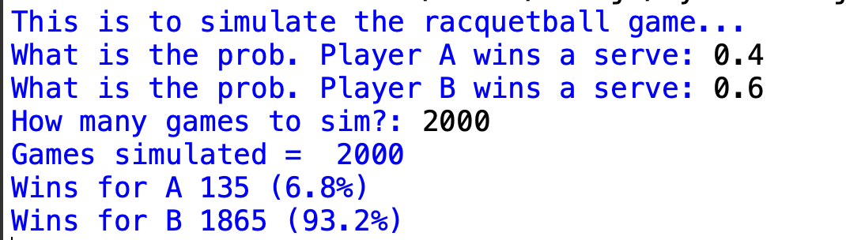
Problem Specification
Input: Program prompts for the service probabilities of 2 player and the number of games to simulate
(Player A and Player B)
Output: Nicely formatted report showing number of games simulated and number of wins with winning percentage for each player.

Slide 34
Randomness
In our simulation the program has to deal with uncertain events
If a player wins 50% of the time that does not mean that every other serve is a winner
More like a coin toss - half the time heads other half tails
Could be five heads in a row.
Racquetball could equally win or lose rallies randomly
Service probability provides a likelihood
No set pattern

Slide 35
Monte Carlo algorithms
Many simulations share property of requiring events to occur with a certain likelihood
Driving simulation – must model unpredictability of other drivers
Bank simulation – must model random arrival of customers
Results depend on “chance” probabilities
BUT Nothing random about computers – they follow instruction
So, how can a computer model random happenings?

Slide 36
Pseudo random number generator
Function: There's a specific function designed to produce numbers that appear random. This is commonly used in computer programs and is known as a pseudo-random number generator (PRNG).
Seed Value: This is an initial input or 'starting point' fed into the PRNG.
Once the seed value is provided, the function will produce a number that seems random.
Repeatability: Even though the outcome appears random, if you use the same seed and apply the same PRNG, you'll get the exact same "random" number every time.
Why "Pseudo"?: This predictable nature (given the same seed) is why we refer to it as "pseudo-random" rather than truly random.
Python has a module called random that provides functions to generate pseudo-random numbers.
The random.seed() function allows you to set the seed value.
Once the seed is set (or even if it's not, as Python will use the current system time as a default seed), you can generate random numbers.

Slide 37
What is the output?
import random
random.seed(30)
print("first Number", random.randint(25, 50))
# generates a different random number
print("Second Number ", random.randint(25, 50))
# will generate a same random number as first one because seed value is same
random.seed(30)
print("Third Number", random.randint(25, 50))

Slide 38

Use in racquetball simulator
Random function can be used to determine whether or not a player wins a serve
Player has a service probability of 0.7
Program decision to increment score by one when serve won
Generate a random value between 0 and 1
70% of the interval is to the left of 0.7
70% of time random number will be < 0.7
30% of time random number will be >= 0.7
If the random number is less than 0.7 (which will happen 70% of the time), the player wins the serve.
If the random number is 0.7 or greater (which will happen 30% of the time), the player loses the serve.
70% of this interval (from 0 to 0.7) represents the chance the player wins.
The remaining 30% (from 0.7 to 1) represents the chance the player loses.

Slide 39
Underestimating the complexity of a program
We have requirements, now let’s think about writing the racquetball simulator

Slide 40
Top-down design
Top-down design starts with a global view of the entire problem and breaks the problem into smaller, more manageable subproblems
Process known as problem decomposition
As each subproblem is isolated, its solution is assigned to a function
As functions are developed to solve subproblems, solution to overall problem is gradually filled out
Process is also called stepwise refinement
Where to begin?
Systematic approach required to create program
Top-down design
Start with general program and express solution in terms of smaller problems
Reapply technique to smaller problems
Keep on applying till problems become trivial to solve
Piece back together and you’ve got a program

Slide 41
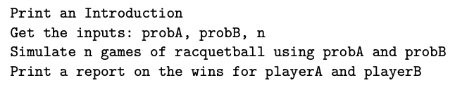
Top-Level Design
Easy to do with pen and paper
Always good to start by studying program specification
Input, process, output
Get simulation inputs, simulate some games, print a report
Basic algorithm:

Slide 42
Going into more depth…
So, design is very high-level
That’s OK
Whatever we don’t know how to do so far, we ignore
Work on stuff we can do
Imagine all the components have already been written
Your job is to finish the top-level algorithm using these components

Slide 43
Separation of Concerns
So, looks good but the main function currently does nothing
We have broken the original problem into 4 independent tasks
We have also specificed names, parameters and expected return values
This information is called the interface of a function
This allows us to tackle pieces independently
For purposes of main, we don’t care how simNGames does its job, just that given parameters it gives back correct number of wins. Main only cares about the what

Slide 44
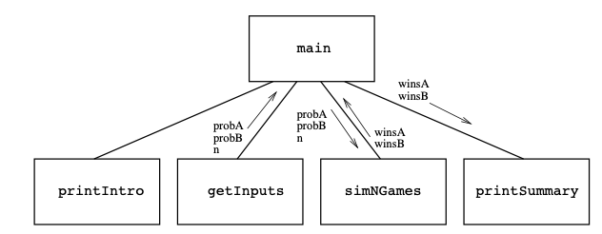
Abstracting to first-level structure

Slide 45
Second-level design
Repeat design process for the remaining components
Lets try this in order
printIntro()
getInputs()

Slide 46
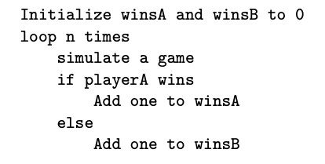
Designing simNGames
This is the real problem
Simulate a number of games and keep track of who wins each
Sounds like a counted loop
Keep track of wins in accumulators
So, lets piece together an algorithm
Let’s beef up the code

Slide 47
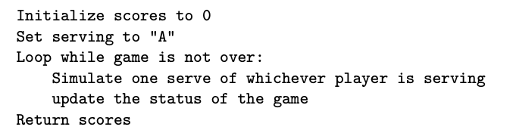
Third-level Design
We keep on going until we have a working solution
Need to work on simOneGame
In this, players keep rallying until game is over
Sounds like an indefinite loop as we don’t know how long that will take
Need to keep track of scores along the way

Slide 48
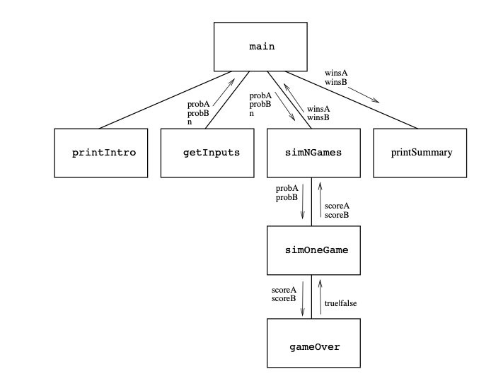
Level 3 structure chart

Slide 49
Nearly there!
Need to complete gameOver function
Checks if a player has score 15 points

Slide 50
Summary of Design Process
Express algorithm as a series of smaller problems
Develop an interface for each of the small problems
Detail the algorithm by expressing it in terms of its interfaces with the smaller problems
Repeat the process for each smaller problem
Invaluable process that you will use again and again for developing complex algorithms
Not easy and takes time but the modular process is necessary for any sophisticated system

Slide 51
Test, test, test
Program complete, but does it work?
No guarantee
Probably some typos etc…
Implementation is also best served in small doses

Slide 52
Unit testing
Start at the lowest levels of your structure chart and work up
Test each component as you complete it
Start with gameOver
Once the function has been typed into a module file, we can import the file and test it
Test, gameOver, then simOneGame with certain probabilities
Function has probabilistic behaviours, so exact output cannot be predicted

Slide 53
Simulation Results
Finally, we can go back to the original question of whether small differences in skill make big differences in the game
Suppose I win 60% of serves and my opponent is 5% better
How often should I win?
Let’s run it and find out over 5,000 games what this might be

Slide 54
Summary
Simulation is powerful technique for answering questions about real-world processes
Simulations relying on probabilistic events are Monte Carlo simulations. Pseudo random numbers can be used to perform these.
Top-down design helps designing complex programs. 4 steps
Unit testing
Design is a combination of art and science. Practice helps you to become a better designer.

Slide 55
Design with Recursive Functions
In top-down design, you decompose a complex problem into a set of simpler problems and solve these with different functions
In some cases, you can decompose a complex problem into smaller problems of the same form
Subproblems can be solved using the same function
This design strategy is called recursive design
Resulting functions are called recursive functions

Slide 56
Design with Recursive Functions
Recursion is a method of solving problems where the solution depends on solutions to smaller instances of the same problem. In programming, a recursive function is a function that calls itself.
A recursive function generally has two parts:
Base Case(s): This is the condition under which the function stops calling itself. It's the simplest possible version of the problem you're trying to solve.
Recursive Case(s): This is where the function calls itself, usually with a simpler version of the problem.

Slide 57
Example - Factorial Calculation
The factorial of a non-negative integer n is the product of all positive integers less than or equal to n. It is denoted by n!.
For example, the factorial of 5 (denoted as 5!) is calculated as:
5! = 5 x 4 x 3 x 2 x 1 = 120
The factorial function can be defined by the product
n! = n*(n-1)*(n-2)*...*3*2*1
There are two important special cases:
The factorial of 0 is 1, i.e., 0! = 1.
The factorial of 1 is also 1, i.e., 1! = 1.

Slide 58
Example - Factorial Calculation
def factorial(n):
# Base case: factorial of 0 or 1 is 1
if n == 0 or n == 1:
return 1
# Recursive case: n! = n * (n-1)!
else:
return n * factorial(n - 1)
When factorial(5) is called:
Since 5 is not equal to 0 or 1, we hit the recursive case. 5 * factorial(4) is returned.
factorial(4) is 4 * factorial(3).
factorial(3) is 3 * factorial(2).
factorial(2) is 2 * factorial(1).
Now, factorial(1) is the base case, which returns 1.
So, factorial(5) is 5 * 4 * 3 * 2 * 1 = 120.

Slide 59
Example - Factorial Calculation
# Recursive version
def factorial_recursive(n):
if n == 0:
return 1
else:
return n * factorial_recursive(n - 1)
# Iterative version
def factorial_iterative(n):
result = 1
for i in range(1, n + 1):
result *= i
return result
In theory, any recursive function can be converted into an iterative function and vice versa. This is because both recursion and iteration are used for repeating certain operations, and so they can be used interchangeably.

Slide 60
Benefits of Recursion
Simplicity: Recursion can simplify code, making it easier to read and understand, particularly when solving problems that are naturally recursive, like tree traversals or sorting algorithms (e.g., QuickSort, MergeSort). The recursive solution often needs fewer lines of code than the iterative one.
Reduction of Complex Problem: A complex problem can be broken down into simpler versions of the same problem, which can make the problem easier to think about and solve.
Elimination of Explicit Stacks/Queues: In several problems, you need to use explicit stack/queue data structures when using iterative methods. This is automatically done by the system in recursive methods, reducing the lines of code.

Slide 61
Benefits of Recursion
Memory Usage: Each recursive call adds a layer to the system call stack, which uses memory. This can lead to high memory use for deeply recursive calls, and in extreme cases, can lead to a stack overflow error.
Efficiency: Recursive functions can be less efficient due to the overhead of the added function calls. Each call creates its own scope with its own local variables, which takes time. An iterative solution may be more efficient for some problems.
Difficulty to Debug: Recursive functions can be more challenging to debug using standard debugging tools, as the function calls are nested within each other, making it harder to track the flow of the program.

Slide 62
Define a function with required and optional parameters
In Python, you can define functions with both required and optional parameters.
Required Parameters
Required parameters (or positional parameters) are the ones that the function needs to work correctly.
When you call a function with required parameters, the arguments you pass in must match the order of the parameters in the function definition.
def greet(name, message):
print(f"Hello, {name}! {message}")

Slide 63
Define a function with required and optional parameters
Optional Parameters
Optional parameters (or default parameters) are parameters that have a default value.
If you don't provide a value for an optional parameter when calling the function, Python uses the default value.
You can call greet() with just a name, and Python uses the default message.
When defining a function, required parameters must come before optional parameters:
def greet(name, greeting="Hello", punctuation="!"):
print(f"{greeting}, {name}{punctuation}")

Slide 64
Define a function with required and optional parameters
def greet(name, greeting="Hello", punctuation="!"):
print(f"{greeting}, {name}{punctuation}")
greet("Alice") # Outputs: Hello, Alice!
greet("Bob", "Good morning") # Outputs: Good morning, Bob!
greet("Charlie", "Hi", "!!") # Outputs: Hi, Charlie!!

Slide 65
Higher-order functions
In Python, higher-order functions are functions that can take other functions as arguments and can also return functions as results. This concept is a key part of functional programming.
Python provides several built-in higher-order functions that are very useful for performing common tasks on sequences like lists. These include map(), filter(), and reduce().

Slide 66
map()
The map() function applies a function to every item in an iterable (like a list) and returns a map object. You can convert the map object to a list using list().
def square(x):
return x * x
numbers = [1, 2, 3, 4, 5]
squares = list(map(square, numbers))
print(squares) # Outputs: [1, 4, 9, 16, 25]

Slide 67
filter()
The filter() function filters the items in an iterable. It applies a function to every item, and if the function returns True, the item is included in the result.
def is_even(x):
return x % 2 == 0
numbers = [1, 2, 3, 4, 5]
even_numbers = list(filter(is_even, numbers))
print(even_numbers) # Outputs: [2, 4]

Slide 68
reduce()
The reduce() function applies a binary function (a function with two arguments) to the items of an iterable in a cumulative way. For example, if you wanted to find the product of all numbers in a list, you could use reduce().
from functools import reduce
def multiply(x, y):
return x * y
numbers = [1, 2, 3, 4, 5]
product = reduce(multiply, numbers)
print(product) # Outputs: 120

Slide 69
Using Lambda to Create Anonymous Functions
In Python, lambda is a keyword used to create anonymous functions. These are functions that are defined without a name.
lambda functions can accept any number of arguments but can only have one expression. The expression is evaluated and returned.
The general syntax for a lambda function is:
A simple example: a lambda function that adds two numbers:
lambda arguments: expression
add = lambda x, y: x + y
print(add(5, 3)) # Output: 8

Slide 70
Using Lambda to Create Anonymous Functions
lambda functions are used when you need a small function for a short period of time and you don't want to use the def keyword to define a function.
This is especially useful when you're working with functions like map(), filter(), and reduce(), or with pandas dataframes where you often need to apply a quick operation to each element or row.
numbers = [1, 2, 3, 4, 5, 6]
even_numbers = filter(lambda x: x % 2 == 0, numbers)
print(list(even_numbers)) # Output: [2, 4, 6]

Slide 71
Creating Jump Tables
A jump table, also known as a dispatch table, is a dictionary of functions to be called on demand.
def add(x, y):
return x + y
def subtract(x, y):
return x - y
def multiply(x, y):
return x * y
def divide(x, y):
if y != 0:
return x / y
else:
return 'Undefined' # avoid division by zero
# Jump table (dispatch table)
jump_table = {
'add': add,
'subtract': subtract,
'multiply': multiply,
'divide': divide
}
# Using the jump table
print(jump_table['add'](10, 5)) # Output: 15
print(jump_table['subtract'](10, 5)) # Output: 5
print(jump_table['multiply'](10, 5)) # Output: 50
print(jump_table['divide'](10, 5)) # Output: 2.0

Slide 72
Chapter Summary
A function serves as abstraction mechanism and eliminates redundant patterns of code
A function hides a complex chunk of code in a single named entity
Allows a general method to be applied in varying situations
Top-down design is strategy that decomposes complex problem into simpler sub-problems and assigns their solutions to functions
Recursive design is special case of top-down design, in which complex problem is decomposed into smaller problems of the same form
Higher-order functions can expect other functions as arguments and/or return functions as values
A mapping function expects a function and a list of values as arguments
A predicate is a Boolean function
A filtering function expects a predicate and a list of values as arguments
A reducing function expects a function and a list of values as arguments

